Slide 1

China Luxury Digital Playbook
No ordinary love – the changing relationship between brands and Chinese millennials

Slide 2







Tencent x BCG luxury consumer insight study
Tencent data
Consumer survey
Copyright © 2017 by The Boston Consulting Group, Inc. All rights reserved.
Data source
Tencent DMP
Tencent platform users’ survey responses
2620 consumers
(luxury buyers in past 12 months)
Luxury touchpoints and purchase pathway
Sample size
1.8mn Chinese luxury consumers (customized BCG x Tencent tags)
Key outputs
Luxury consumer profiling
1

Slide 3

Chinese luxury consumers to drive global luxury growth
Chinese personal luxury market to grow at 6% CAGR
40% of global true luxury market will be in China
€ billion, retail value
€ billion, retail value
162
409
+6%
31%
+4%
327
98
105
69%
247
95
28%
Copyright © 2017 by The Boston Consulting Group, Inc. All rights reserved.
27%
28%
222
72%
162
73%
73%
105
40%
32%
2015
2016 2017
Accessible luxury
2024F
2017
2024F
True luxury
70%
¤of global growth
1. Monthly household disposable income >23k RMB in 2016 prices
Note: Chinese includes purchases abroad; personal includes leather accessories, apparel, watches and jewelry and perfumes and cosmetics Source: BCG Luxury Market Model
2

Slide 4








36%
32%
28 Average
8%
13%
Age
6%
6%
<18
TGI¹ 47
18-24
148
25-30
140
31-35
111
36-40
88
41+
24
They are very young, better educated, more female
63%
Education
12%
16%
8%
Primary school
High school
College degree
Graduate or Ph.D
Copyright © 2017 by The Boston Consulting Group, Inc. All rights reserved.
TGI¹
100
145
321
505
71%
29%
Gender
Male
Female
TGI¹ 54 176
1. TGI measures whether the group is over or under represented compared to the general population (base = 100) Source: BCG X Tencent Luxury Study, 2018
3

Slide 5


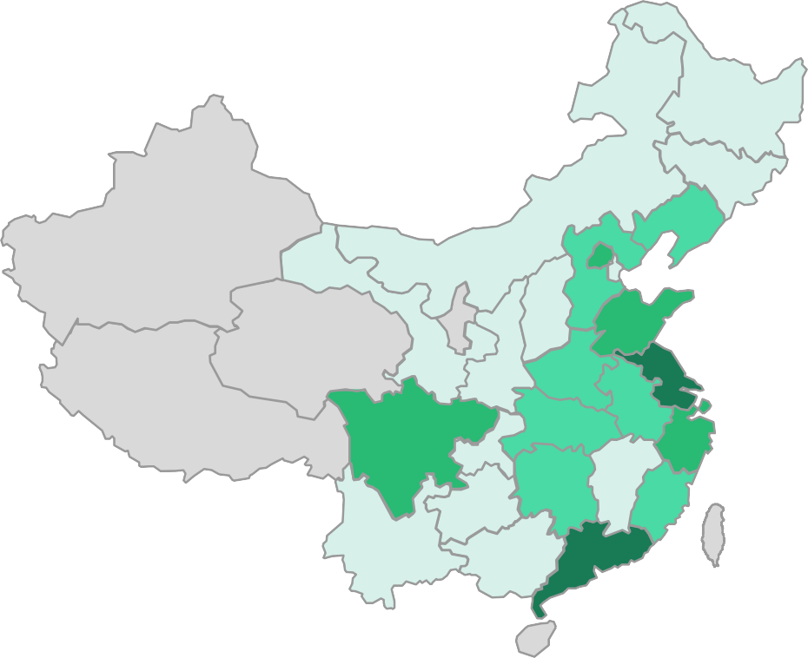







Over 50% of luxury consumers live beyond top 15 cities
% of luxury consumers
City tier
# of cities
Top 4
20%
4
Shandong Jiangsu
Tier 1
22%
11
Copyright © 2017 by The Boston Consulting Group, Inc. All rights reserved.
Sichuan
Zhejiang
Tier 2
22%
32
Luxury consumers
7%+
5-7%
3-5%
1-3%
0-1%
Guangdong
Tier 3
and below
36%
2,158
Source: BCG X Tencent Luxury Study, 2018; BCG MAC database
4

Slide 6
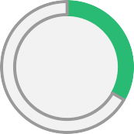

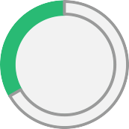











They are attached to mobile app throughout the day
% of luxury users logged onto Tencent apps throughout the day
Daily ‘mobile’ time per user (min)
0:00-
8:00-
16:00-
100%
8:00
16:00
24:00
WeChat
+QQ
87
Mobile games
45
Copyright © 2017 by The Boston Consulting Group, Inc. All rights reserved.
50%
Video, News and
Music
75
0%
News
Video
Music
Source: BCG X Tencent Luxury Study, 2018
5

Slide 7



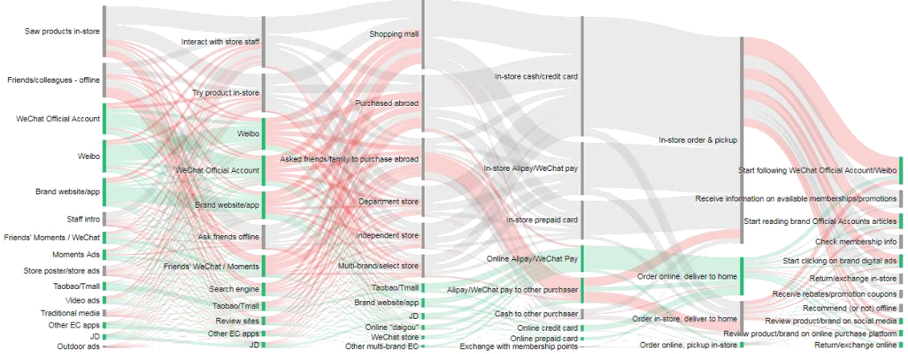
Luxury purchase pathway is highly fragmented …
Discovery
Research
Purchase
Payment
Delivery
After sales
Copyright © 2017 by The Boston Consulting Group, Inc. All rights reserved.
Source: BCG X Tencent Luxury Study, 2018
6

Slide 8



… driving shift of luxury from offline to online
Online Offline
Total mix
Research vol.
Purchase vol.
Research vol.
Purchase vol.
% of purchase by channel
Traditional Luxury
Brand highly rely on physical presence
Offline¹
2012
100%
Online
0%
Offline¹
Copyright © 2017 by The Boston Consulting Group, Inc. All rights reserved.
Digital Luxury 1.0
Traffic shift from offline to online channel
2017
95%
Online
5%
Offline¹
Digital Luxury 2.0
Traffic conversion uplift as on/offline integrates
85-90%
2023
Online
10-15%
1. ~1/3 of offline purchased volume comes from ROPO (research online purchase offline)
Bubble size = Traffic volume (consumer)
7

Slide 9
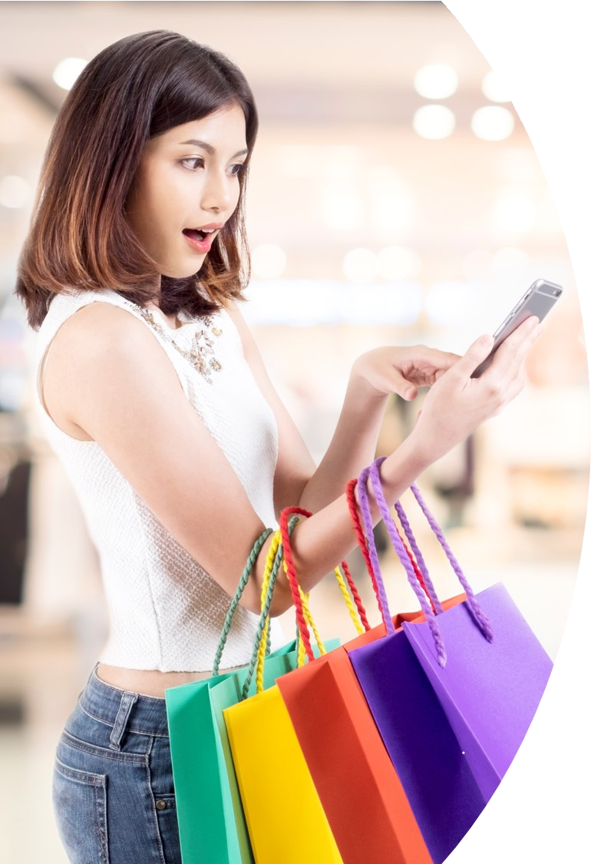


Over 50% of luxury consumer attention online, mainly mobile super APP
Chinese KOL important touchpoint to reach luxury consumers
¤6
Brand Official Account becoming an impactful way to reach and engage
¤trends re-defining the rule of game
Research online purchase offline (ROPO) is the dominant purchase pathway
Copyright © 2017 by The Boston Consulting Group, Inc. All rights reserved.
Low-tier luxury consumers active in digital; cluster- based targeting more effective to reach them
Marketplace dominates luxury e-commerce, yet social-linked shopping rapidly emerging
8

Slide 10
Over 50% of luxury consumer attention is online, mostly on mobile …
1
Earned traffic: 18%
Traditional media: 3%
Discovery touchpoints by consumer attention
Organic traffic: 29%
Online/mobile Offline
14%
4%
3%
Other digital media traffic: 26%
29%
Copyright © 2017 by The Boston Consulting Group, Inc. All rights reserved.
Social content traffic: 24%
7%
100%
8%
11%
12%
12%
KOL (on Brand Social
Brand web and mini- program
Digital impression- based advertising¹
Third-party EC
Store
Offline word- Online word- of-mouth of-mouth
TVC/Print/ Event/OOH
Total
WeChat Media (WeChat
and Weibo) and Weibo)
1. Primarily Moments ads and OTV ads Source: BCG X Tencent Luxury Study, 2018
9

Slide 11







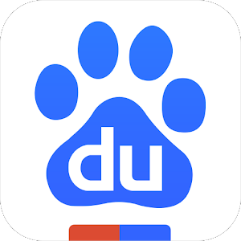




… attention focuses platform consolidated by super APP
1
¤Dominance of mobile time by Tencent
Social
¤WeChat
¤QQ
¤Mini- program Store
¤Weibo
¤Tmall
¤Taobao
2017 share of time spent on smartphones (%)
E-com
Copyright © 2017 by The Boston Consulting Group, Inc. All rights reserved.
News & info
¤Tencent News
¤Weibo
¤Baidu
Tencent 50%
Facebook 22%
¤Xiami Music
¤Baidu Music
Music
¤QQ Music
OTV
¤Tencent Video
¤e.g. Honor of Kings
¤Youku
¤iQiyi
China
US
Games
Source: BCG China Internet Trends Report
10

Slide 12




Chinese KOLs important touchpoint to reach luxury consumers
2
Top 30 Tencent KOL accounts by % of followers among luxury users
1
Gogoboi
2
Becky’s Fantasy
3
Mr. Bags
_{11%} 10%
10%
Average: 3.2%
Copyright © 2017 by The Boston Consulting Group, Inc. All rights reserved.
1 2 3
While top KOLs have widest reach, they are not necessarily followed or liked by your target consumer
Brands should work with Tencent’s analytics to identify which long-tail KOLs are most relevant
Source: BCG X Tencent Luxury Study, 2018
11

Slide 13
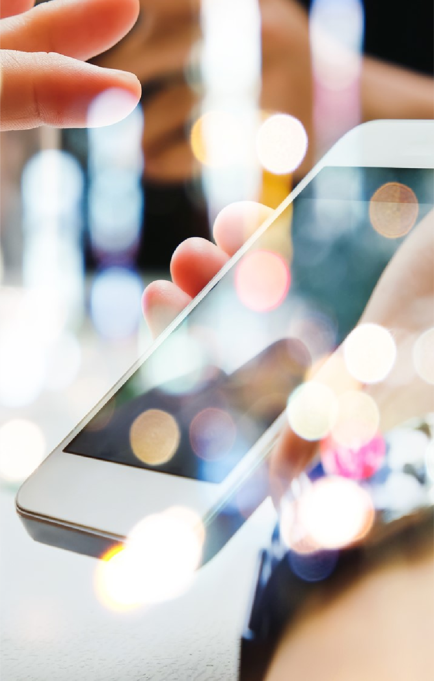

Brand Official Account becoming an impactful way to reach and engage
3
Average views per Official Account article (indexed)
Copyright © 2017 by The Boston Consulting Group, Inc. All rights reserved.
~20k views per article on average, though top brands' articles can hit >100k views
Brands can invest resources to make content more engaging, and/or co-develop new content formats with Tencent
Note: Average views of last 3 articles on WeChat Official Account Source: Brand accounts on WeChat, BCG analysis
12

Slide 14


ROPO is the dominant purchase pathway
4
Our observations
ROPO relevance driven by:
58%
ROPO
New luxury buyers educate themselves online before entering store
~45% of online-inspired consumers buy abroad due to pricing and/or lack of stores
12%
100%
26%
3%
Copyright © 2017 by The Boston Consulting Group, Inc. All rights reserved.
32%
8%
20%
Online solo to grow as EC platforms in China further develop luxury offering (e.g. Tmall Luxury Pavilion, JD Toplife)
Store solo | Store solo | ROPO – | ROPO - | Showrooming | Online-solo | Total
- domestic | - abroad¹ | China | abroad¹
1. Researched Online, Purchased Offline Source: BCG X Tencent Luxury Study, 2018
13

Slide 15





Digital is crucial to reach and convert consumers living in lower tier cities
5
Consumers by city tier
Top 4 and Tier 1 Tier 2
Consumer journey type
Tier 3 and below
ROPO
(research online, purchase offline)
64%
56%
51%
Copyright © 2017 by The Boston Consulting Group, Inc. All rights reserved.
Pure offline
28%
29%
27%
Pure online
8%
9%
16%
Showrooming
(research offline, purchase online)
1%
5%
6%
Note: Abroad purchases includes asking friends/family to purchase abroad Source: BCG X Tencent Luxury Study, 2018
14

Slide 16
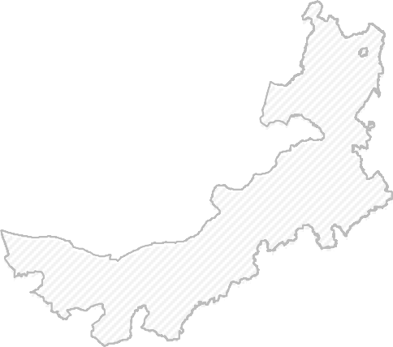
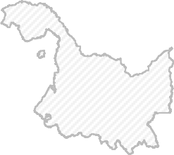
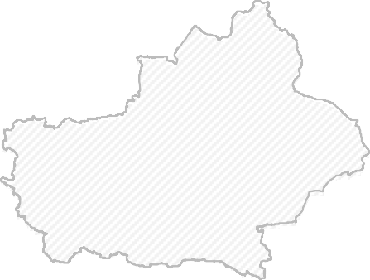


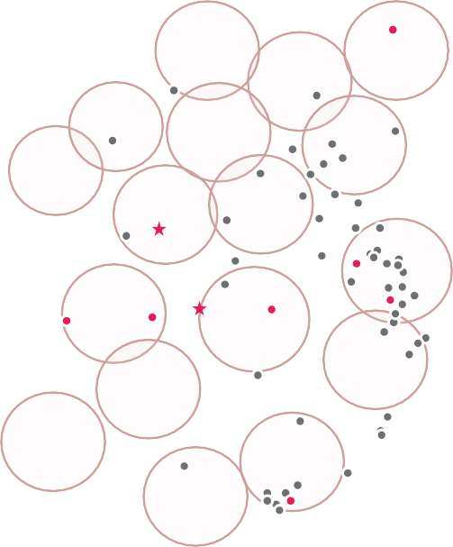






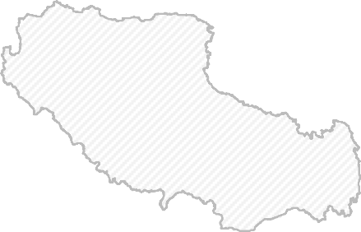


















Location-based cluster approach helps amplify brand marketing reach
5
Chuzhou (Tier 5) is less than 20 mins train to Nanjing (Tier 1), I travel there to buy luxury goods several times a year
— 28 years old, Chuzhou
Shenyang
Beijing
Tianjin
Copyright © 2017 by The Boston Consulting Group, Inc. All rights reserved.
Xi'an
Nanjing _{Suzhou}
_{Chengdu} Chongqing
Wuhan
Hangzhou
Consumers from Liaocheng (Tier 4) typically go to Jinan (Tier 2) for luxury goods. Therefore, we only do marketing in high-tier cities
— Luxury brand Sales Manager
City categories
Emerging Top Tier
Cluster
Note: 18 official clusters defined by Gov based on proximity and intensity of economic activities Source: BCG MAC database
Guangzhou
Shenzhen
15

Slide 17













Marketplace dominates luxury e-commerce, yet social- linked shopping emerging fast
6
¤Generalist marketplace
(e.g. T-mall, Ali Pavilion, JD, JD Toplife)
¤Mono-brand website
Social media linked sales
(e.g. WeChat)
¤Luxury multi-brand
(e.g. NAP, Farfetch)
¤Online flash sales
(e.g. VIP)
¤Off price
¤e-tailer
Copyright © 2017 by The Boston Consulting Group, Inc. All rights reserved.
51%
23%
11%
8%
7%
N/A
23%
33%
2%
32%
4%
6%
Source: BCG X Tencent Luxury Study, 2018
16

Slide 18
Over 50% of luxury consumer attention online, mainly mobile super APP
Chinese KOL important touchpoint to reach luxury consumers
¤6
Brand Official Account becoming an impactful way to reach and engage
¤trends re-defining the rule of game
Research online purchase offline (ROPO) is the dominant purchase pathway
Copyright © 2017 by The Boston Consulting Group, Inc. All rights reserved.
Low-tier luxury consumers active in digital; cluster- based targeting more effective to reach them
Marketplace dominates luxury e-commerce, yet social-linked shopping rapidly emerging
17

Slide 19










Online to offline
Offline to offline
Online to online
Social gifting
Social-linked gift cards and coupons
SCRM tools
Online sales platform
‘Wechat For Work’²
Wechat store, mini-program
KOL amplification
A broad range of tools
re-defining the rule of the game
E.g. Online celebrities as SA
New retail application
Personalized online offerings
LBS ads/shopper instant discounts
Scan and go/order
Targeted messages in Wechat OA
LBS Moment Ads
Offline engagements
Online content and social marketing
Wechat OA articles, mini programs
Copyright © 2017 by The Boston Consulting Group, Inc. All rights reserved.
O2O gamification/engagement
Instore tournaments
/interactive screen
E.g. O2O treasure hunt game¹
Impression-driven marketing tools: QQ Music, OTV, etc.
Licensed IP for promotion and product differentiations
Data-driven member management
Store-level shopper profiling and traffic analysis
18

